Slide 1

Collecting and Analyzing Provenance on Interactive Notebooks: when IPython meets noWorkflow
João Felipe Nicolaci Pimentel (UFF), Juliana Freire (NYU), Leonardo Murta (UFF), Vanessa Braganholo (UFF)

Slide 2
Outline
Motivation
Exploratory research
Example
Interactive Notebooks
Example
Provenance Limitations
Approach
Provenance Collection
Provenance Analysis
Conclusion

Slide 3
Motivation

Slide 4
Exploratory research
Implement or Change
Execution
Analysis
Hypothesis

Slide 5
Example of exploratory research
Analyze precipitation data from Rio de Janeiro
Hypothesis: “The precipitation for each month remains constant across years”
Data: 2013, 2014 [BDMEP]
Implement or Change
Execution
Analysis
Hypothesis

Slide 6
1| import numpy as np
2| import matplotlib.pyplot as plt
3| from precipitation import read, prepare
4|
5| def bar_graph(years):
6| global PREC, MONTHS
7| prepare(PREC, MONTHS, years, plt)
8| plt.savefig("out.png")
9|
10| MONTHS = np.arange(12) + 1
11| d13, d14 = read('p13.dat'), read('p14.dat')
12| PREC = prec13, prec14 = [], []
14| for i in MONTHS:
15| prec13.append(sum(d13[i]))
16| prec14.append(sum(d14[i]))
18| bar_graph(['2013', '2014'])

Slide 7
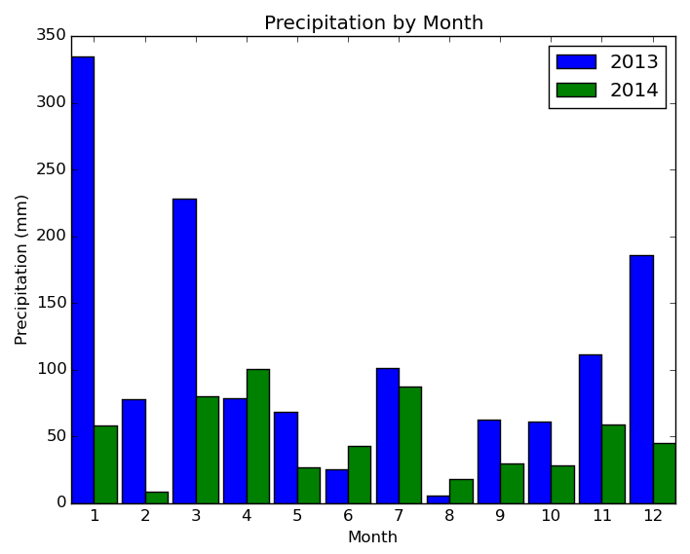
1st Iteration
$ python experiment.py
$ display out.png
Analysis: “Drought in 2014”
New Hypothesis:
Data: 2012, 2013, 2014 [BDMEP]
“The precipitation for each month remains constant across years if there is no drought”

Slide 8
2nd Iteration
10| MONTHS = np.arange(12) + 1
11| d12 = read('p12.dat')
12| d13, d14 = read('p13.dat'), read('p14.dat')
13| PREC = prec12, prec13, prec14 = [], [], []
14|
15| for i in MONTHS:
16| prec12.append(sum(d12[i]))
17| prec13.append(sum(d13[i]))
18| prec14.append(sum(d14[i]))
19|
20| bar_graph(['2012', '2013', '2014'])

Slide 9
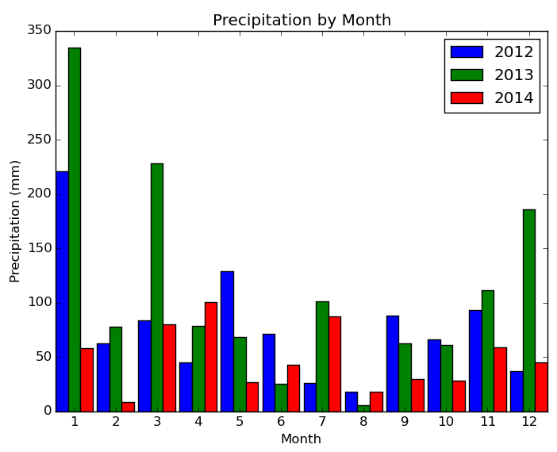
2nd Iteration
$ python experiment.py
$ display out.png
Analysis: “2012 was similar to 2013”
Cycle continues

Slide 10
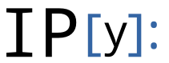
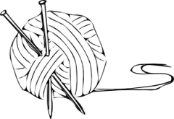
Interactive Notebooks
Documents
Text, code, plots, rich media
Share the documents with results
Most famous:
IPython Notebook, knitr
IPython Notebook has more than 500,000 active users
Good for exploratory research

Slide 11
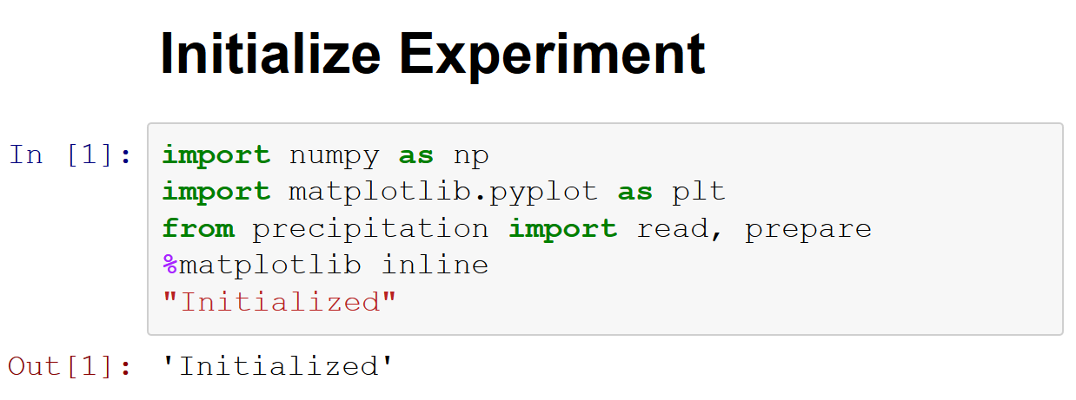
Example - 1st Iteration

Slide 12
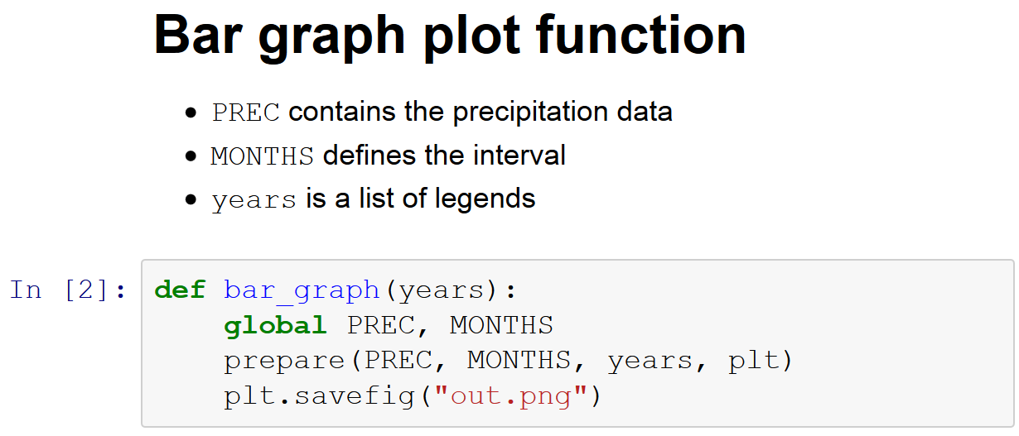

Slide 13
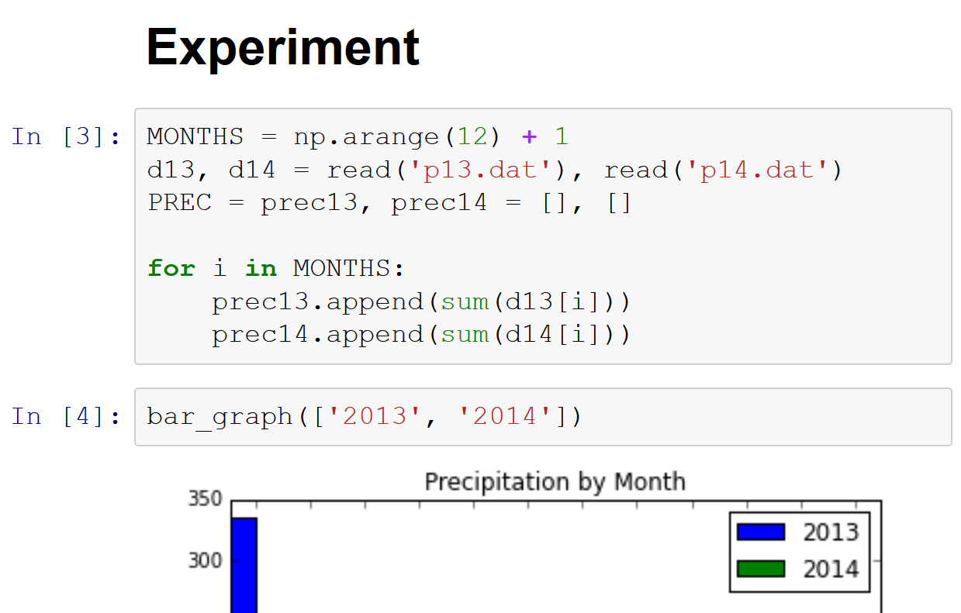

Slide 14
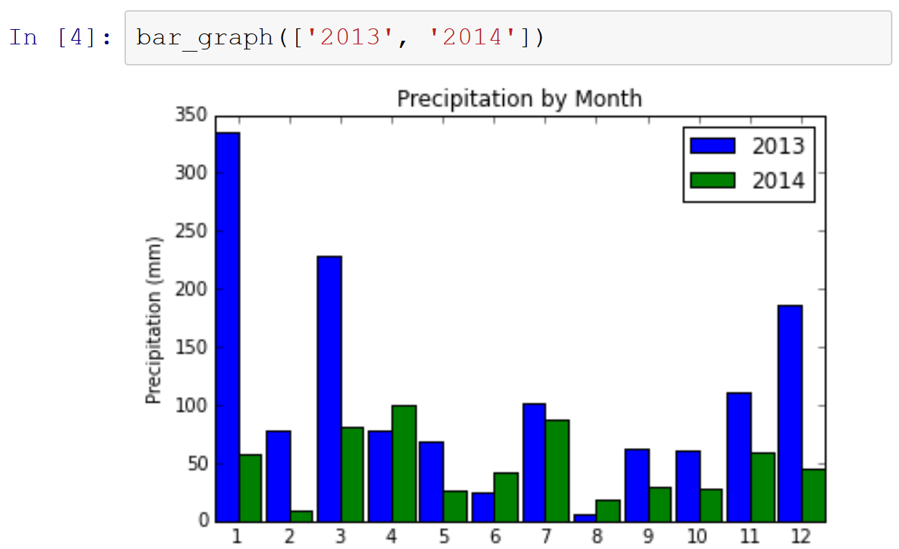

Slide 15
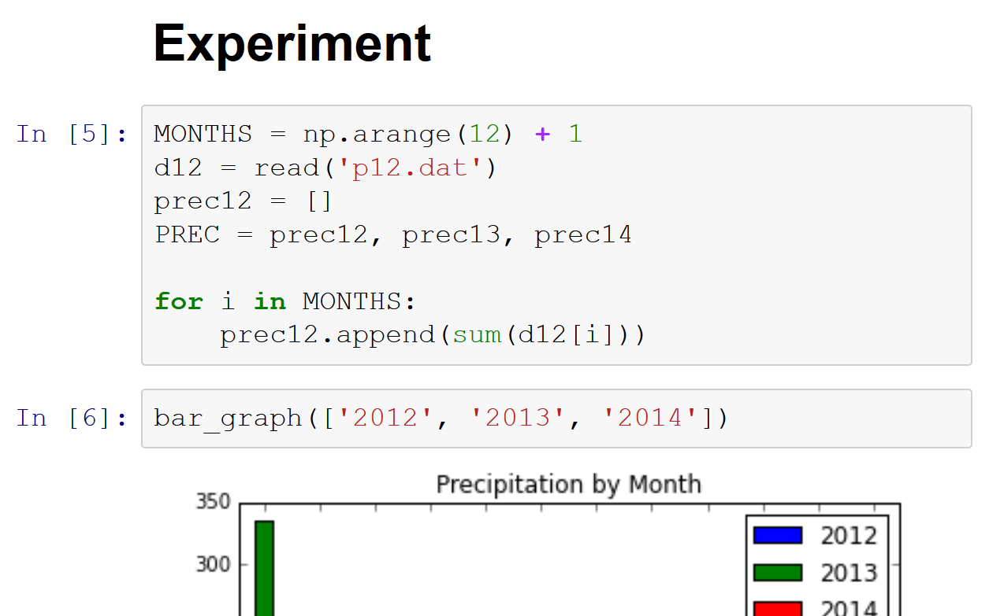

Slide 16
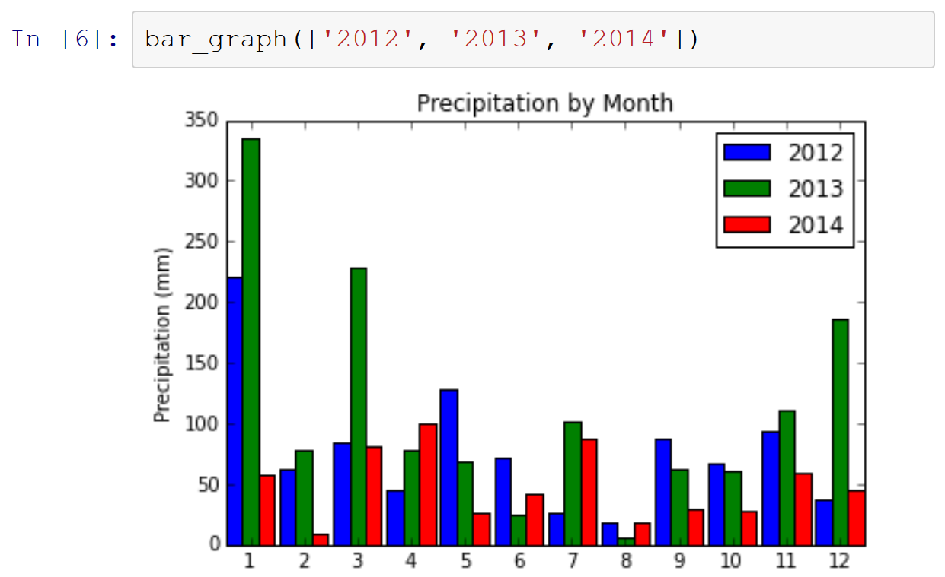

Slide 17
Exploratory research
Change
Execution
Analysis
Hypothesis
Change existing cells
Add new one
Interactive Notebooks
Execute cells
Observe the results
Use code for analysis

Slide 18
Provenance Limitations
Which version of matplotlib, numpy and precipitation module is it using? Will it work on another environment?

Slide 19
Provenance Limitations
The cell [3] were replaced by [5]. Where did the “prec13” and “prec14” come from? What changed from [3] to [5]?

Slide 20
Provenance Limitations
What happens inside the cell? What does read('p12.dat') return? How long did it take to execute each function?

Slide 21
Provenance Limitations
What is the content of 'p12.dat'?

Slide 22
Provenance of Python Scripts
API: (Bochner; Gude; Schreiber, 2008)
Require API calls
StarFlow (Angelino; Yamins; Seltzer, 2010)
Require annotations
Sumatra (Davison, 2012)
Require version control system
noWorkflow (Murta et al., 2014)
Transparent collection
None supports notebooks

Slide 23


noWorkflow
Transparently captures provenance of Python scripts – no changes required!
Allows users to analyze provenance data

Slide 24
1.9.2
1| import numpy as np
2| import matplotlib.pyplot as plt
3| from precipitation import read, prepare
4|
5| def bar_graph(years):
6| global PREC, MONTHS
7| prepare(PREC, MONTHS, years, plt)
8| plt.savefig("out.png")
9|
10| MONTHS = np.arange(12) + 1
11| d13, d14 = read('p13.dat'), read('p14.dat')
12| PREC = prec13, prec14 = [], []
14| for i in MONTHS:
15| prec13.append(sum(d13[i]))
16| prec14.append(sum(d14[i]))
18| bar_graph(['2013', '2014'])
1.4.3
1.0.1
PATH = /home/joao/...
PYTHON_VERSION = 2.7.6

Slide 25
1| import numpy as np
2| import matplotlib.pyplot as plt
3| from precipitation import read, prepare
4|
5| def bar_graph(years):
6| global PREC, MONTHS
7| prepare(PREC, MONTHS, years, plt)
8| plt.savefig("out.png")
9|
10| MONTHS = np.arange(12) + 1
11| d13, d14 = read('p13.dat'), read('p14.dat')
12| PREC = prec13, prec14 = [], []
14| for i in MONTHS:
15| prec13.append(sum(d13[i]))
16| prec14.append(sum(d14[i]))
18| bar_graph(['2013', '2014'])
PREC = [[…], […]]
MONTHS = array(1,…,12)
p13.dat content b/a
p14.dat content b/a
read(‘p14.dat’) -> {1: [
7.1, 0.8, 0.0, …],
2: …}

Slide 26
noWorkflow
Objective
Interactive
Provenance
noW
Interactive + Provenance

Slide 27
Approach

Slide 28
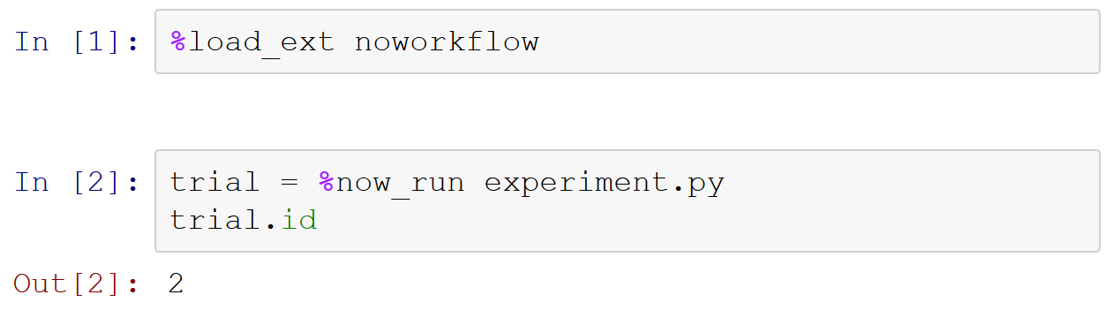
Provenance Collection – 1 / 2

Slide 29
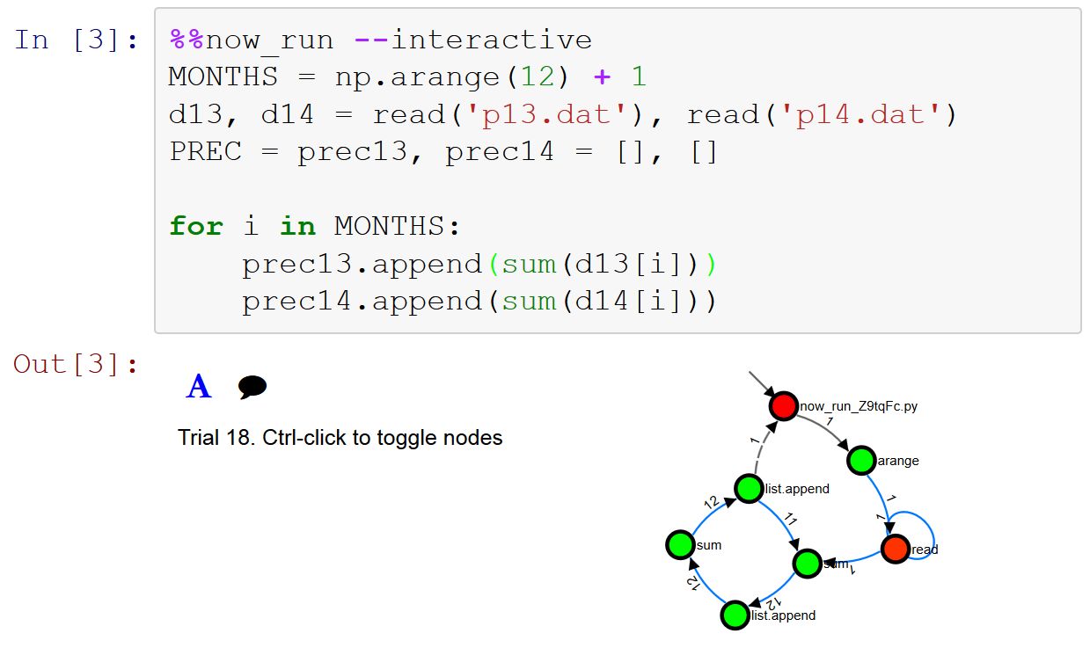
Provenance Collection – 2 / 2

Slide 30
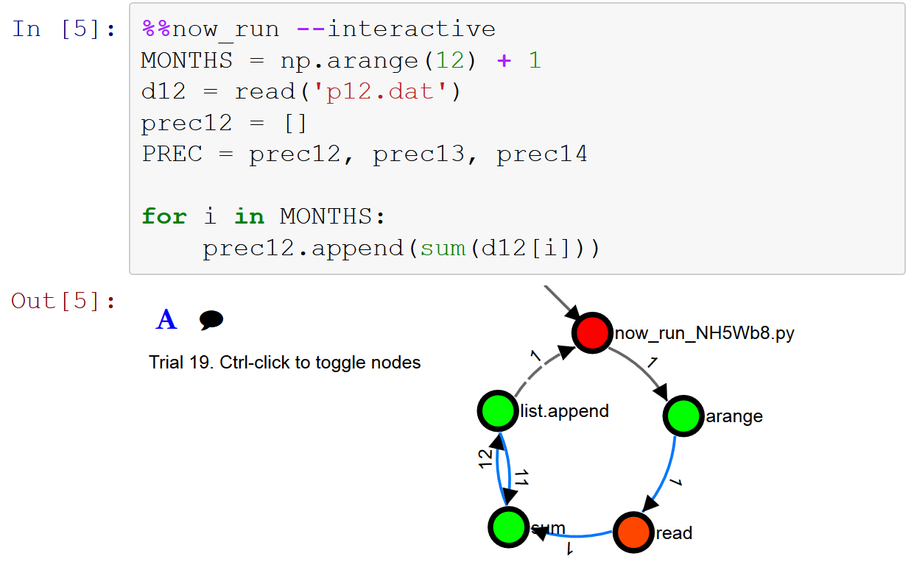
Provenance Collection – 2 / 2

Slide 31
Provenance Analysis
Call trial methods and properties
Load Trial
Trial visualization
Perform SQL queries
Perform Prolog queries
Read file content before and after writing
Advanced Analysis

Slide 32
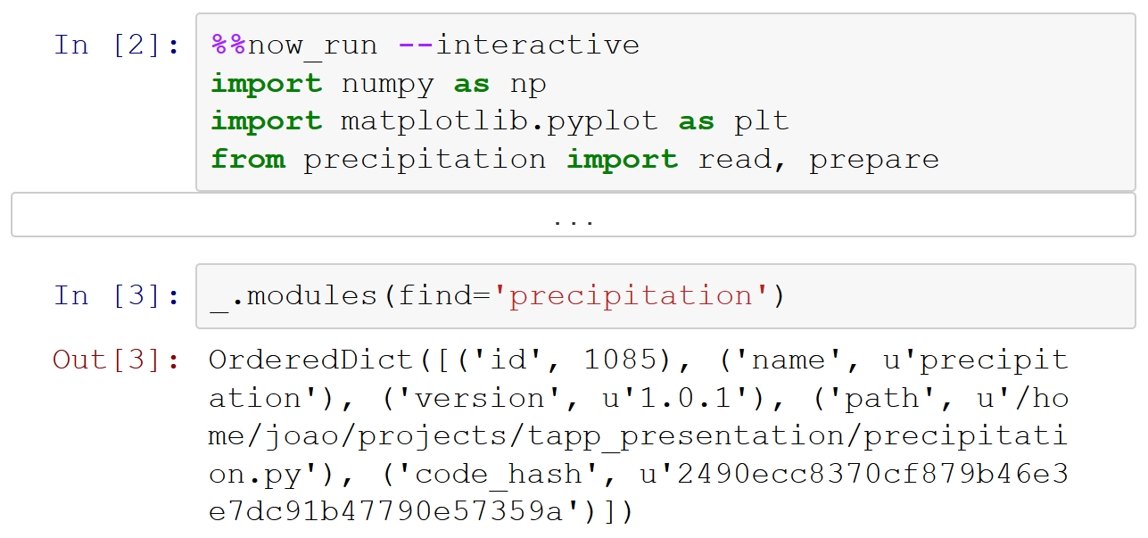
Call Trial Method
Which version of precipitation module is it using?

Slide 33
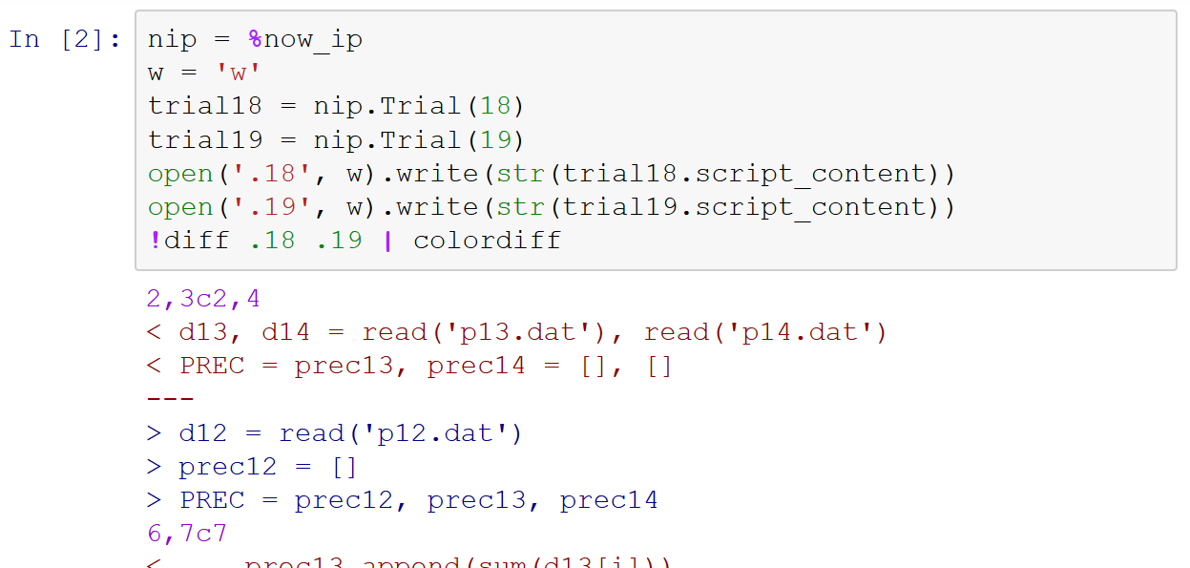
Load Trial
What changed from [3] to [5]?

Slide 34
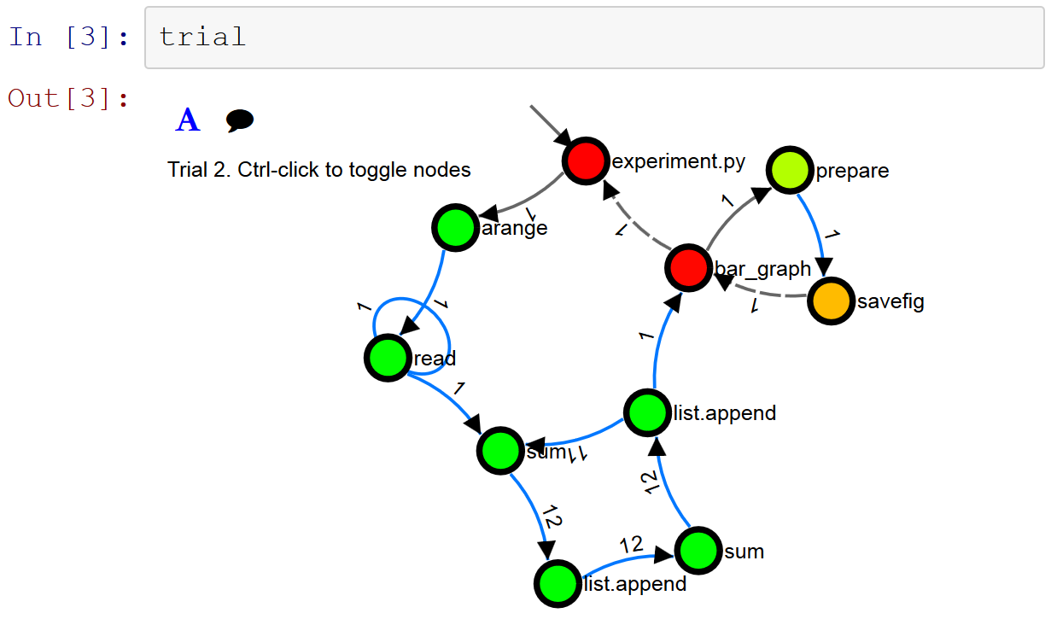
Provenance Visualization
What happened inside the cell?

Slide 35
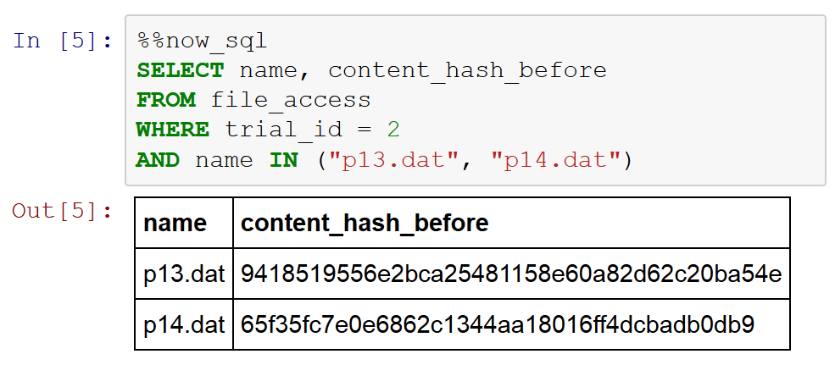
SQL Queries

Slide 36
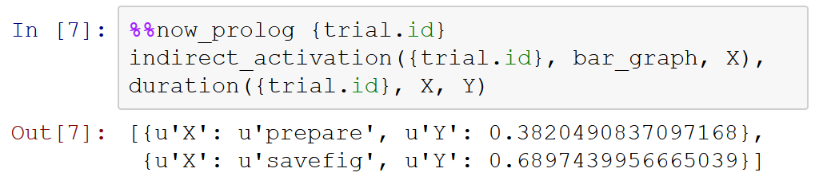
Prolog Queries

Slide 37
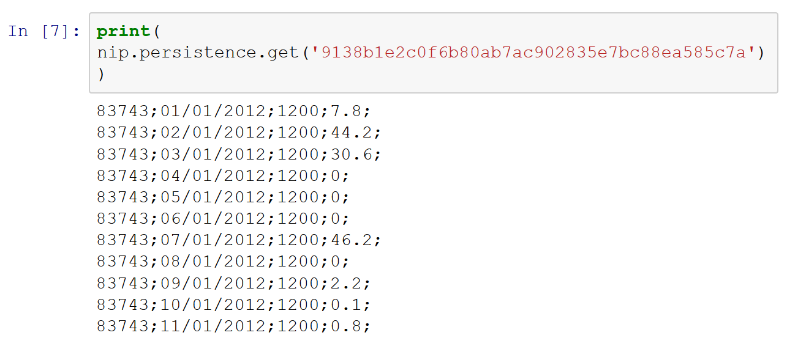
Read file content
What is the content of 'p12.dat'?

Slide 38
Advanced Analysis
Combine:
Python code
SQL queries
Prolog queries
File content
External tools

Slide 39
Limitations
Capture one cell at a time.
It is necessary to repeat “%%now_run” for every cell
No Out [x]
The Out [x] is replaced by the trial object
No IPython superset
It is not possible to invoke other special commands

Slide 40
Related Work
Ducktape (Wibisono et al., 2014)
Use notebook only for interactive provenance visualization
Lancet (Stevens, Elver, Bednar, 2013)
Requires definition of special launchers to capture provenance
Steep learning curve

Slide 41
Conclusion
Mechanism to collect and analyze provenance from IPython Notebooks
Invoke noWorkflow through special functions
Analytic tools: SQL queries, Prolog queries, object properties, graphs
noWorkflow tracks history, environment, intermediate results and files
Reproducible notebook!

Slide 42
Future Work
New visualization methods for Provenance
Dependency graph
Diff visualization
Integration with Pandas
Improve data analysis
Collect provenance from other languages supported by Jupyter

Slide 43
Collecting and Analyzing Provenance on Interactive Notebooks: when IPython meets noWorkflow
joaofelipenp@gmail.com
https://github.com/gems-uff/noworkflow
João Felipe Nicolaci Pimentel (UFF), Juliana Freire (NYU), Leonardo Murta (UFF), Vanessa Braganholo (UFF)

Slide 44
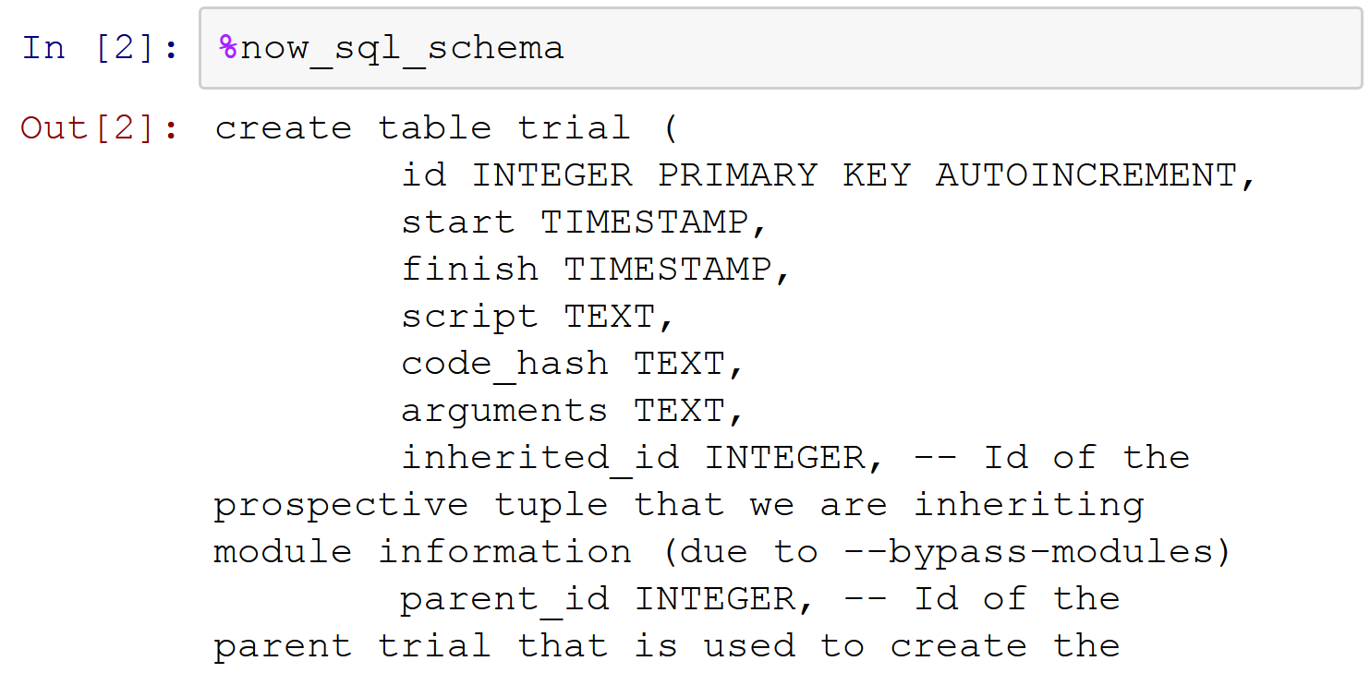
SQL Schema

Slide 45
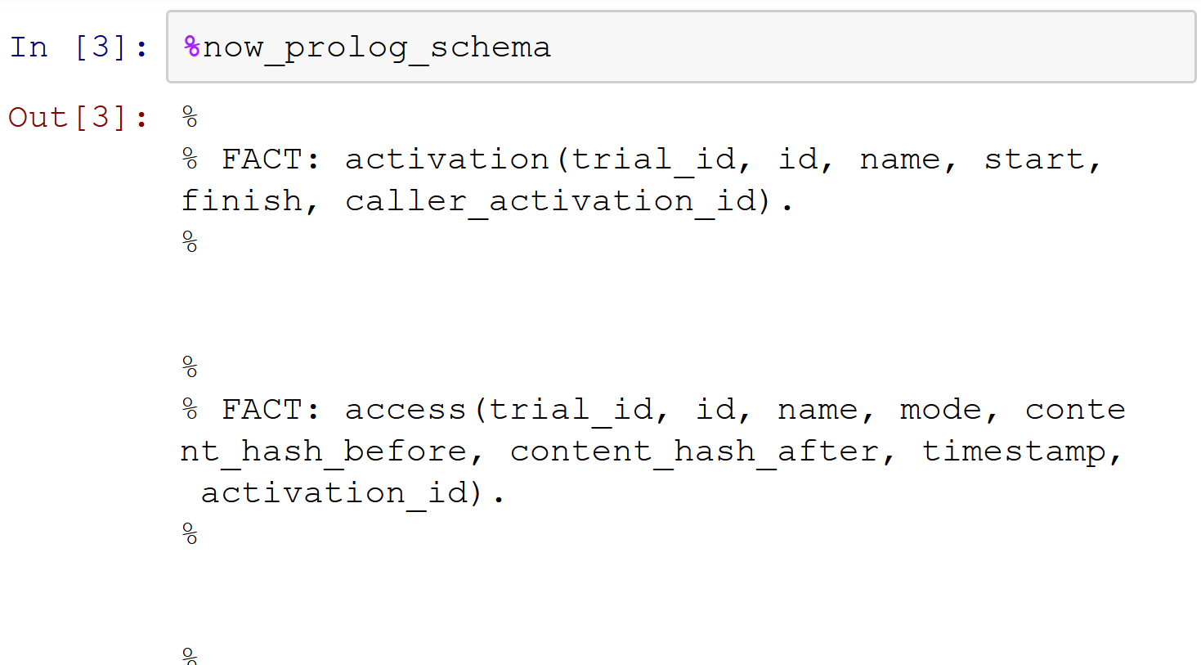
Prolog Schema

Slide 46
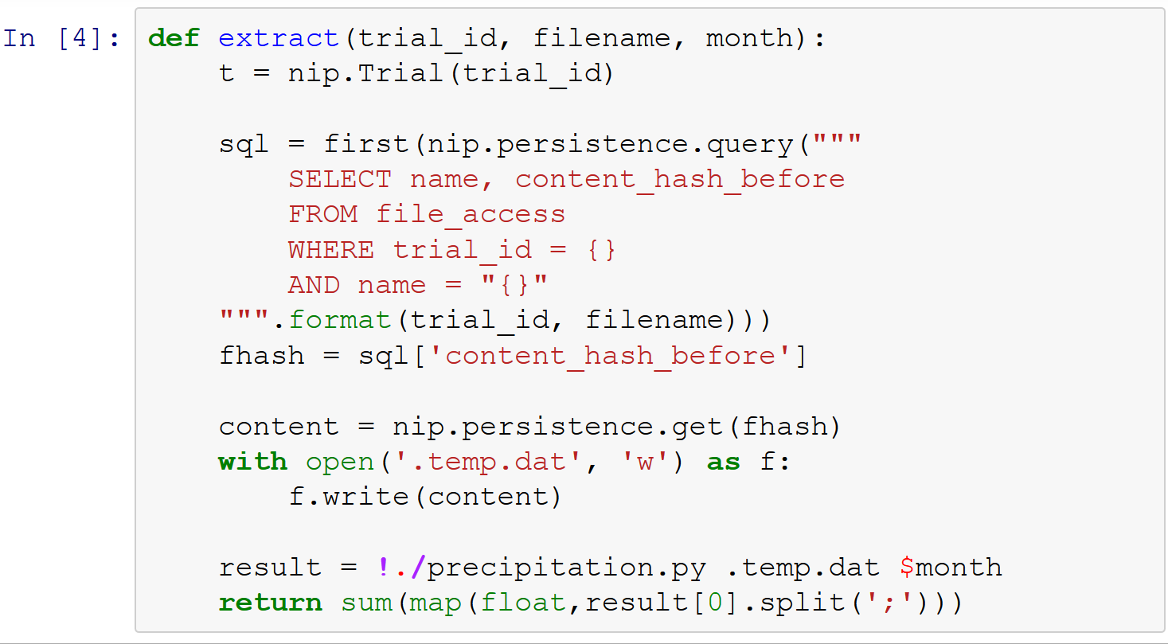
Complex Analysis

Slide 47
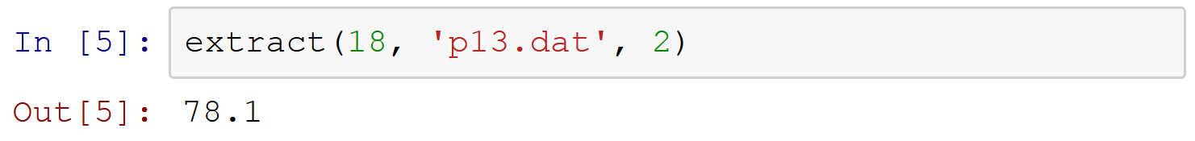
Complex Analysis

